Slide 1



Lab 11
CNN
With TF 1.0!
Sung Kim <hunkim+ml@gmail.com>
Code: https://github.com/hunkim/DeepLearningZeroToAll/

Slide 2

Call for comments
Please feel free to add comments directly on these slides
Other slides: https://goo.gl/jPtWNt
Picture from http://www.tssablog.org/archives/3280

Slide 3
Lab 11-1
CNN Basics
With TF 1.0!
Sung Kim <hunkim+ml@gmail.com>
Code: https://github.com/hunkim/DeepLearningZeroToAll/

Slide 4

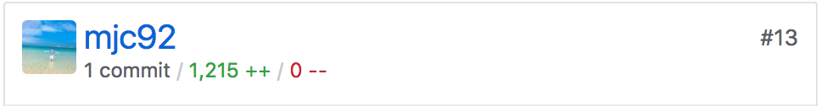
https://github.com/hunkim/DeepLearningZeroToAll/

Slide 5
CNN
http://parse.ele.tue.nl/cluster/2/CNNArchitecture.jpg

Slide 6
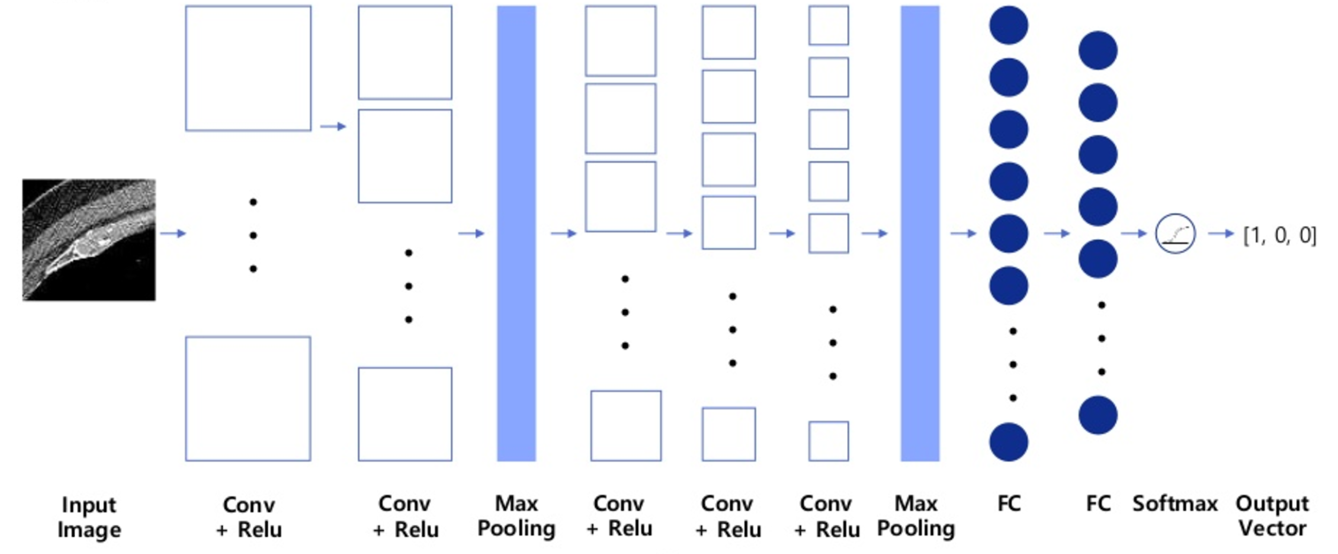
CNN for CT images
Asan Medical Center & Microsoft Medical Bigdata Contest Winner by GeunYoung Lee and Alex Kim
https://www.slideshare.net/GYLee3/ss-72966495

Slide 7
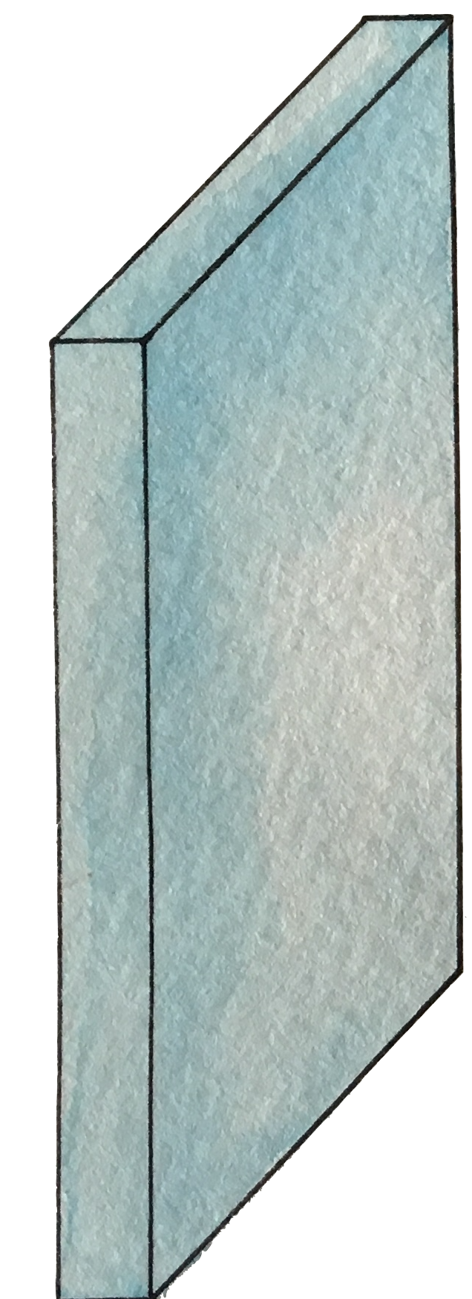
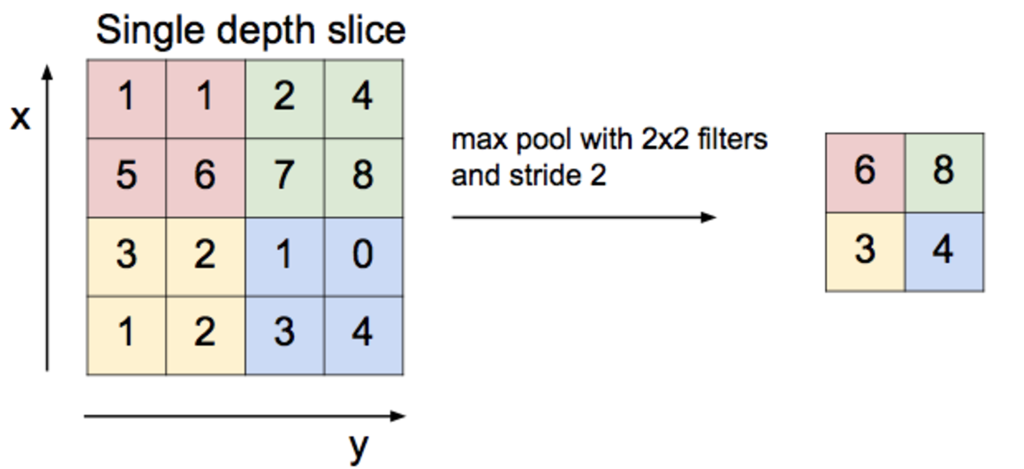
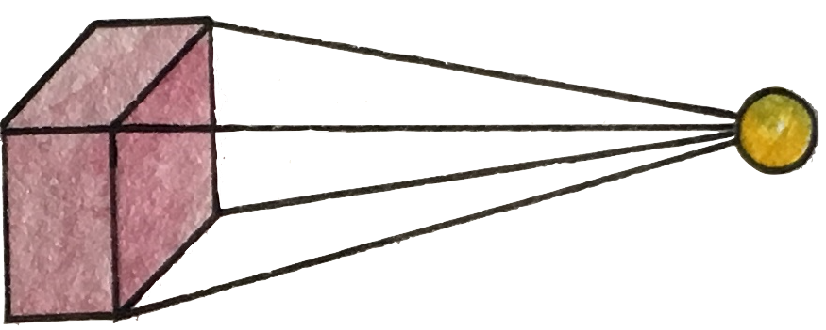
Convolution layer and max pooling

Slide 8
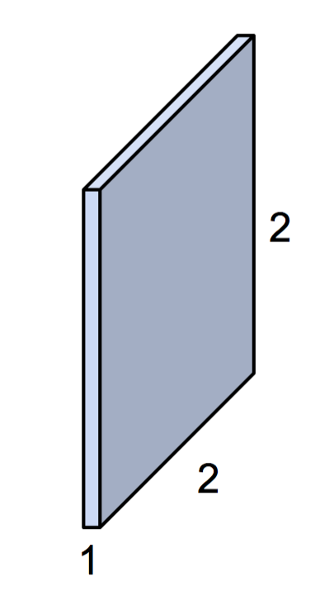
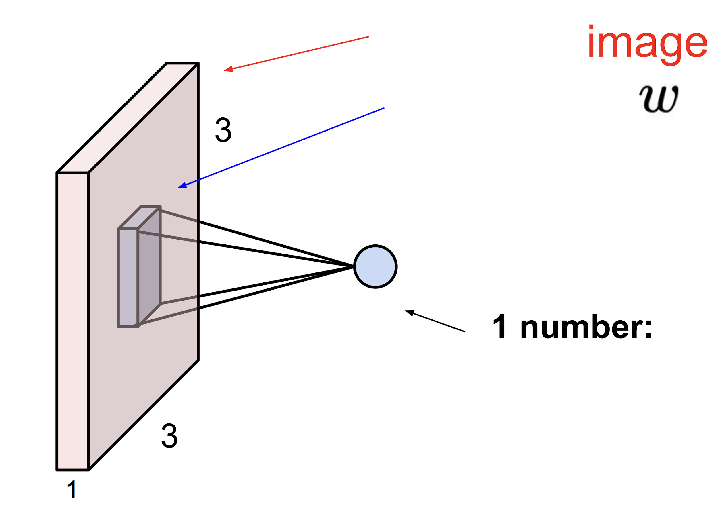
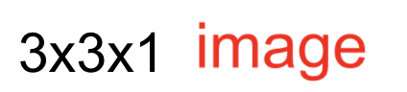
Simple convolution layer
Stride: 1x1
3x3x1
2x2x1 filter

Slide 9
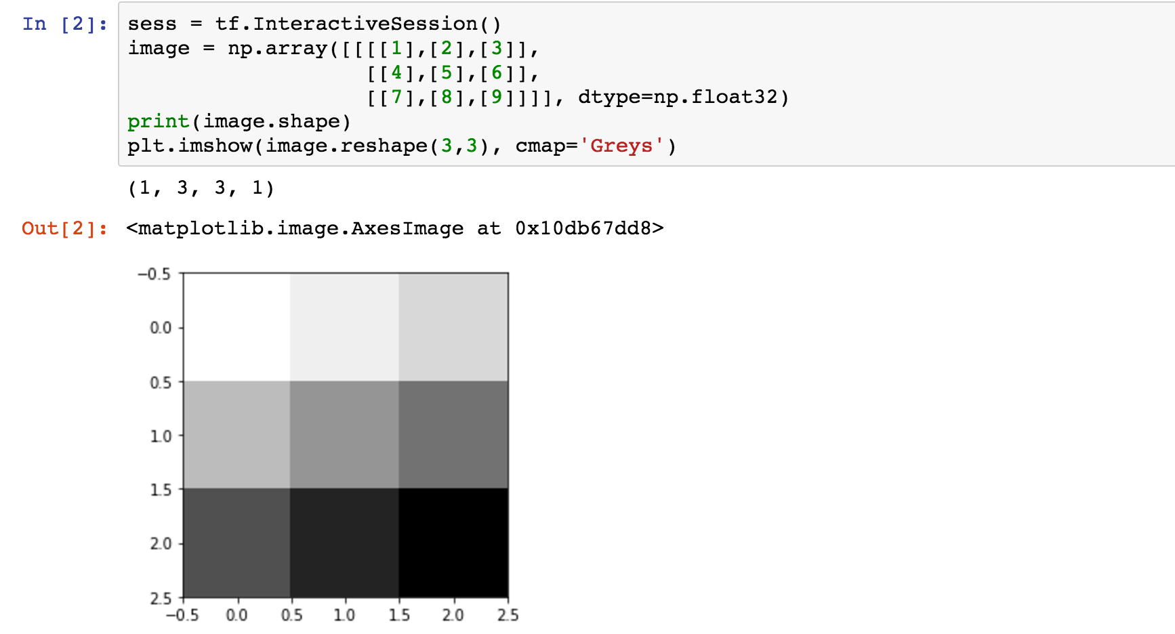
Toy image

Slide 10
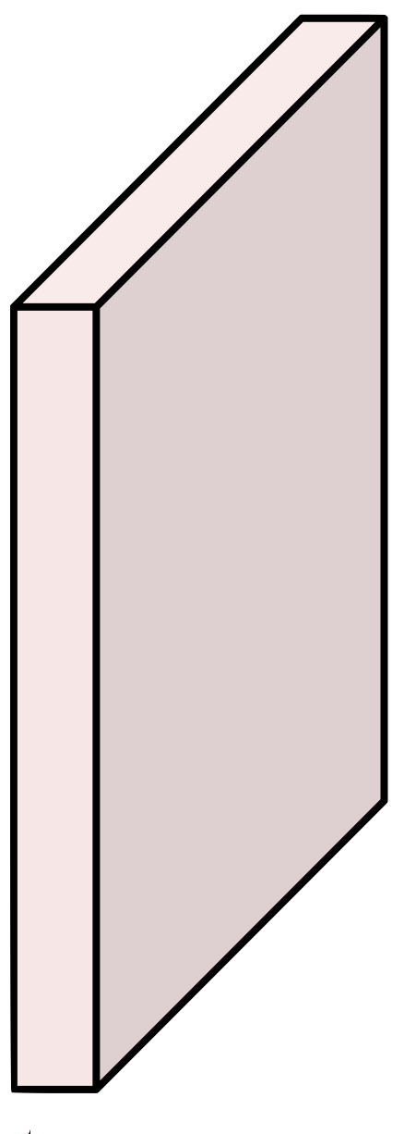
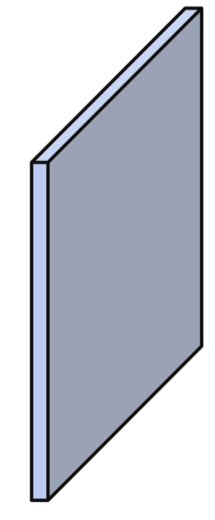
Simple convolution layer
Image: 1,3,3,1 image, Filter: 2,2,1,1, Stride: 1x1, Padding: VALID
3
2
1
6
1
5
1
4
1
9
8
1
7
[[[[1.]],[[1.]]],
[[[1.]],[[1.]]]]
shape=(2,2,1,1)

Slide 11
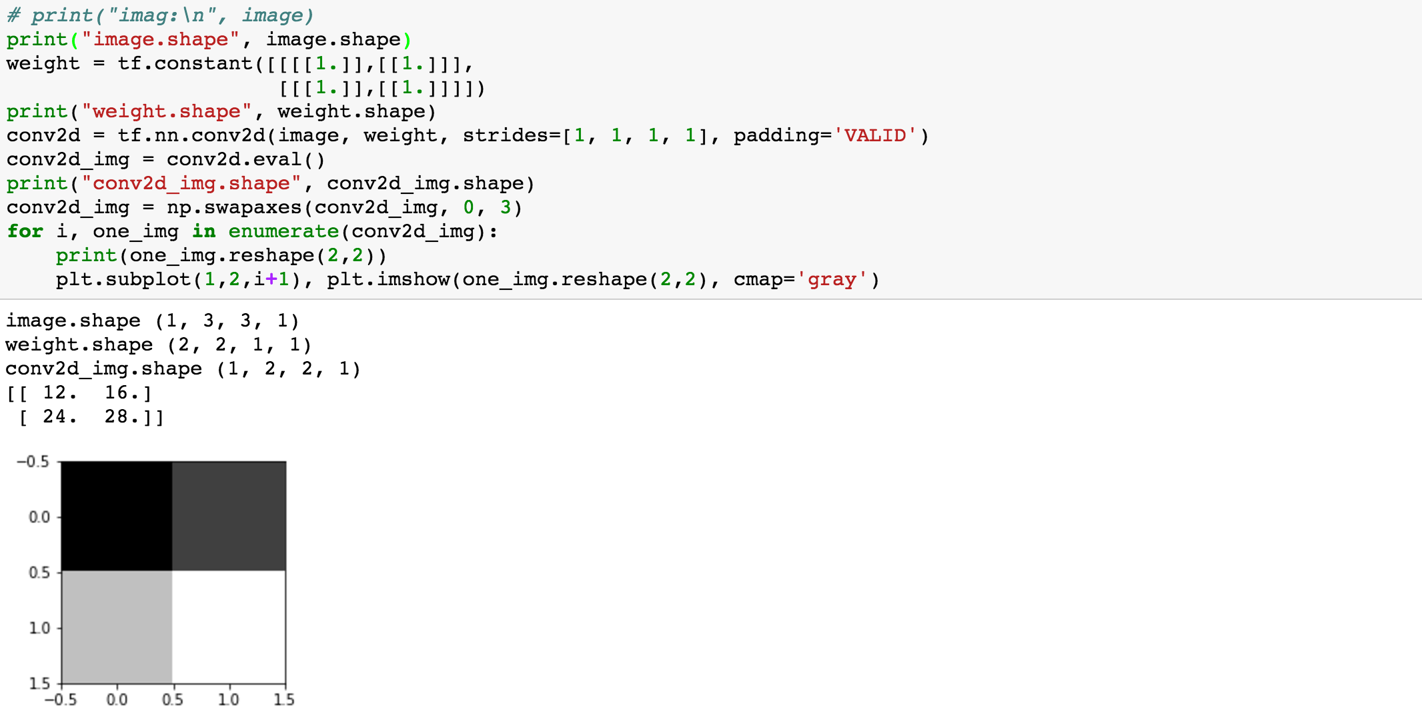
Image: 1,3,3,1 image, Filter: 2,2,1,1, Stride: 1x1, Padding: VALID
3
2
1
6
1
5
1
4
1
9
8
1
7

Slide 12
Simple convolution layer
Image: 1,3,3,1 image, Filter: 2,2,1,1, Stride: 1x1, Padding: SAME
0
3
2
1
0
6
1
5
1
3
4
0
1
9
8
0
1
7
0
3
0
0

Slide 13
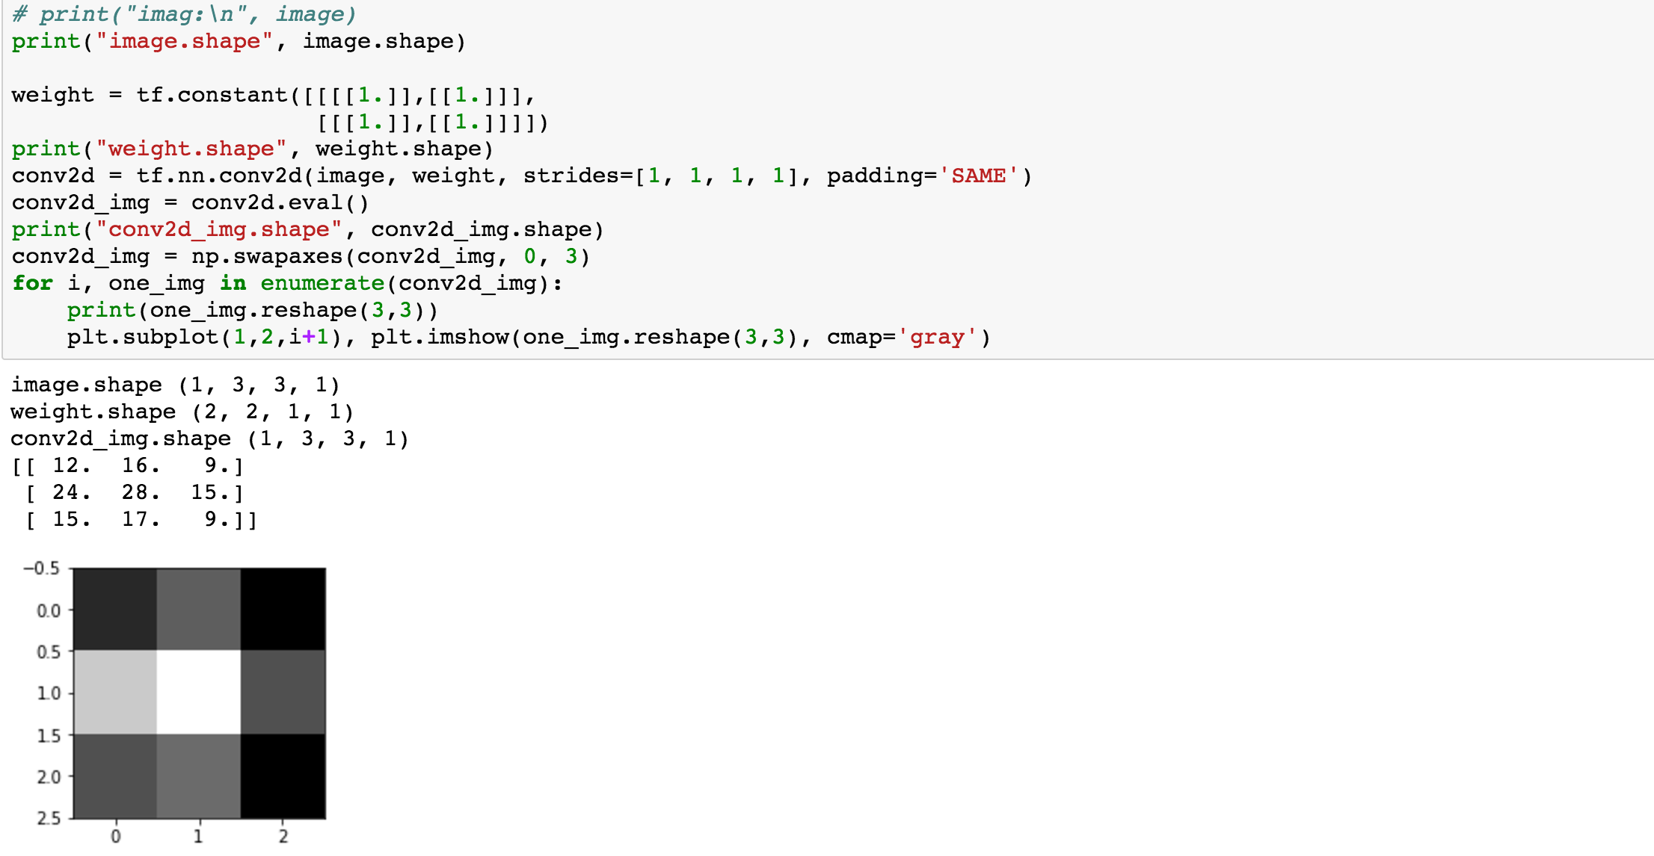
Image: 1,3,3,1 image, Filter: 2,2,1,1, Stride: 1x1, Padding: SAME
0
3
2
1
0
6
1
5
1
4
0
1
9
8
0
1
7
0
0
0

Slide 14
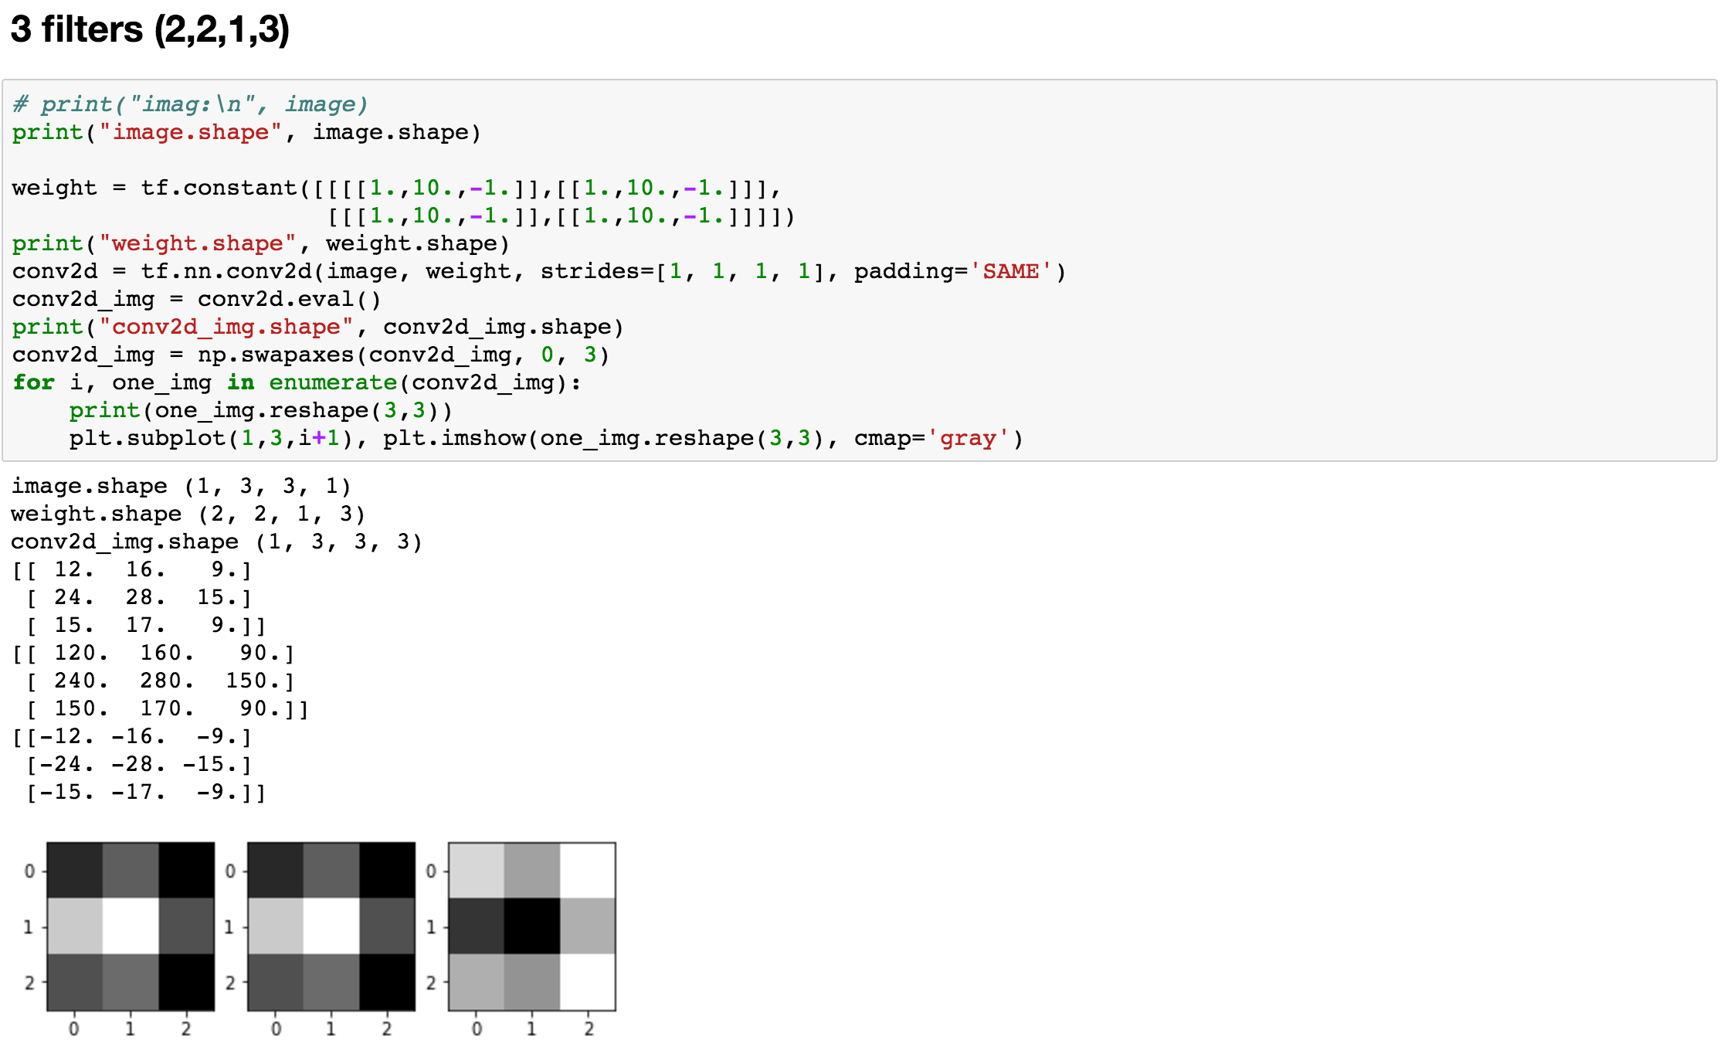

Slide 15
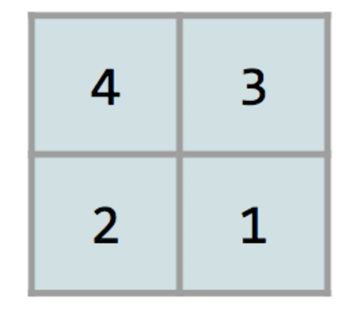
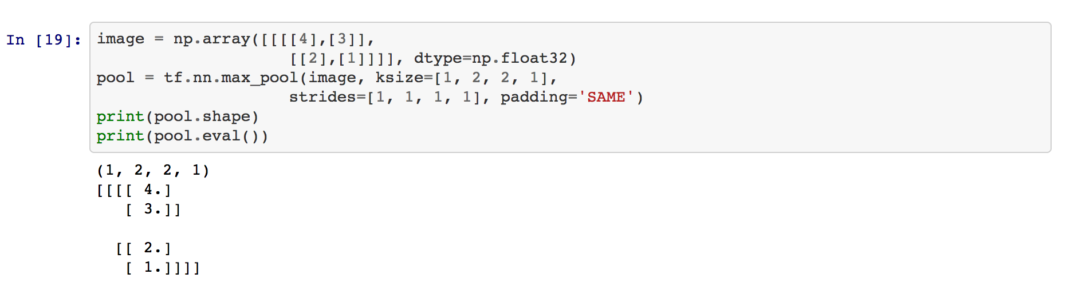
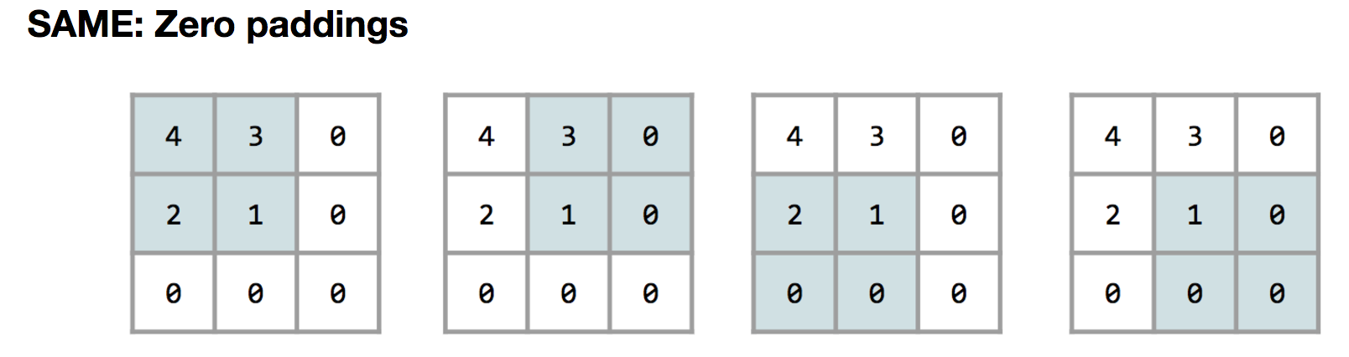
Max Pooling
https://github.com/hunkim/DeepLearningZeroToAll/blob/master/lab-11-0-cnn_basics.ipynb

Slide 16
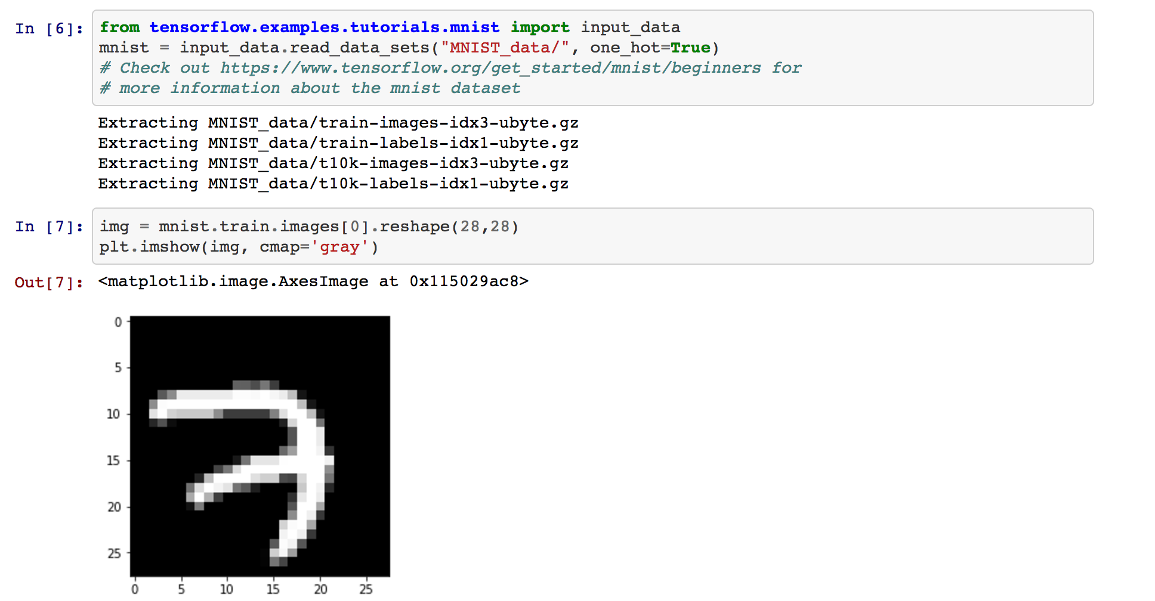
MNIST image loading
https://github.com/hunkim/DeepLearningZeroToAll/blob/master/lab-11-0-cnn_basics.ipynb

Slide 17
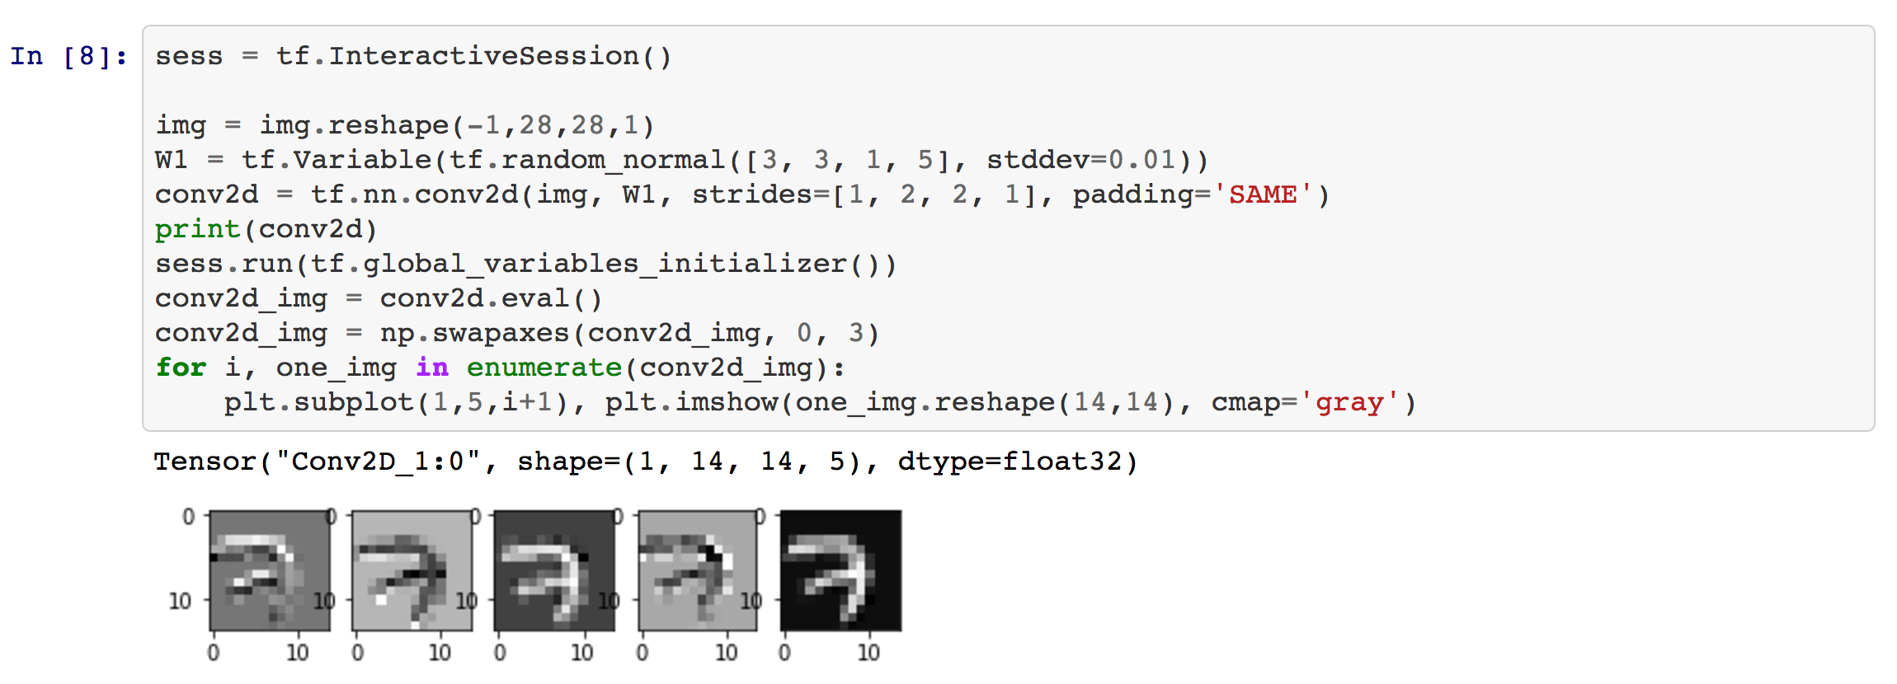
MNIST Convolution layer
https://github.com/hunkim/DeepLearningZeroToAll/blob/master/lab-11-0-cnn_basics.ipynb

Slide 18
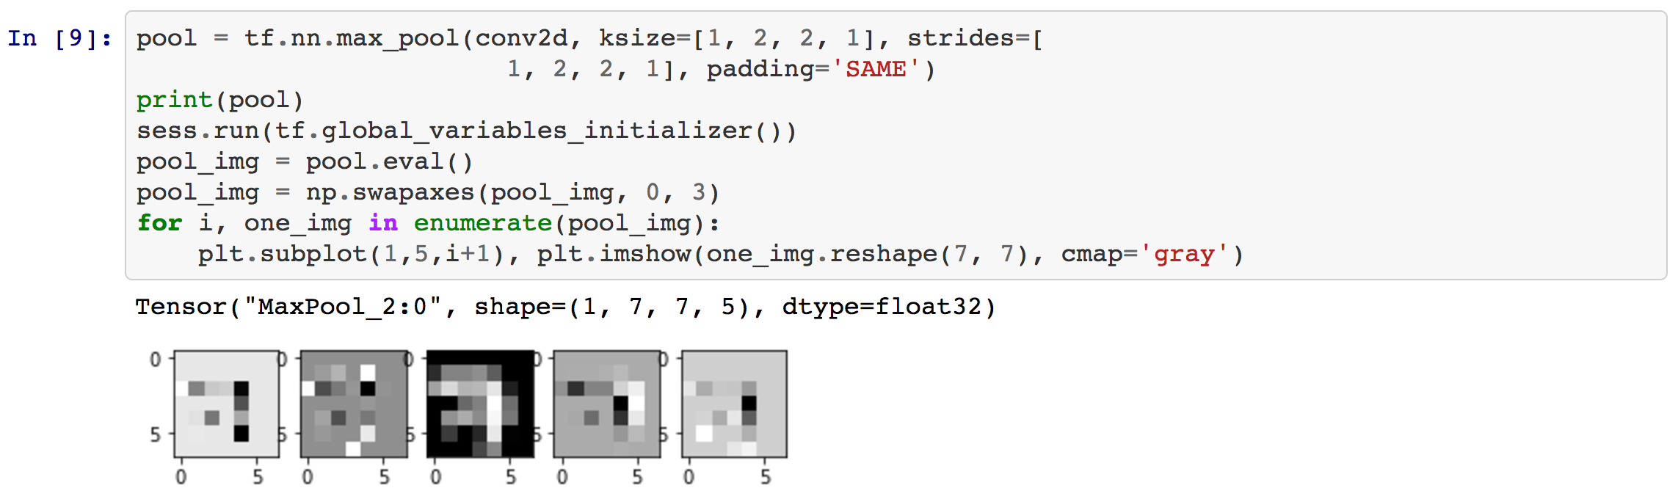
MNIST Max pooling
https://github.com/hunkim/DeepLearningZeroToAll/blob/master/lab-11-0-cnn_basics.ipynb

Slide 19
Lab 11-2
CNN MNIST: 99%!
With TF 1.0!
Sung Kim <hunkim+ml@gmail.com>
Code: https://github.com/hunkim/DeepLearningZeroToAll/

Slide 20
https://github.com/hunkim/DeepLearningZeroToAll/

Slide 21
CNN
http://parse.ele.tue.nl/cluster/2/CNNArchitecture.jpg

Slide 22
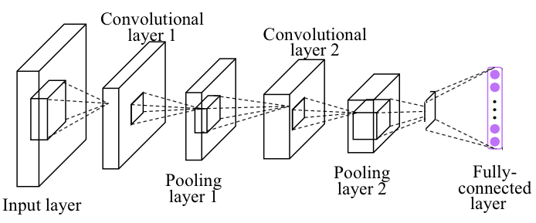
Simple CNN

Slide 23
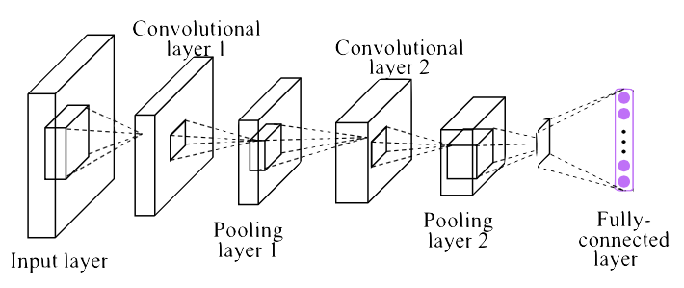
Conv layer 1
# input placeholders
X = tf.placeholder(tf.float32, [None, 784])
X_img = tf.reshape(X, [-1, 28, 28, 1]) # img 28x28x1 (black/white)
Y = tf.placeholder(tf.float32, [None, 10])
# L1 ImgIn shape=(?, 28, 28, 1)
W1 = tf.Variable(tf.random_normal([3, 3, 1, 32], stddev=0.01))
# Conv -> (?, 28, 28, 32)
# Pool -> (?, 14, 14, 32)
L1 = tf.nn.conv2d(X_img, W1, strides=[1, 1, 1, 1], padding='SAME')
L1 = tf.nn.relu(L1)
L1 = tf.nn.max_pool(L1, ksize=[1, 2, 2, 1],
strides=[1, 2, 2, 1], padding='SAME')
'''
Tensor("Conv2D:0", shape=(?, 28, 28, 32), dtype=float32)
Tensor("Relu:0", shape=(?, 28, 28, 32), dtype=float32)
Tensor("MaxPool:0", shape=(?, 14, 14, 32), dtype=float32)
'''
https://github.com/hunkim/DeepLearningZeroToAll/blob/master/lab-11-1-mnist_cnn.py

Slide 24
Conv layer 2
'''
Tensor("Conv2D:0", shape=(?, 28, 28, 32), dtype=float32)
Tensor("Relu:0", shape=(?, 28, 28, 32), dtype=float32)
Tensor("MaxPool:0", shape=(?, 14, 14, 32), dtype=float32)
'''
# L2 ImgIn shape=(?, 14, 14, 32)
W2 = tf.Variable(tf.random_normal([3, 3, 32, 64], stddev=0.01))
# Conv ->(?, 14, 14, 64)
# Pool ->(?, 7, 7, 64)
L2 = tf.nn.conv2d(L1, W2, strides=[1, 1, 1, 1], padding='SAME')
L2 = tf.nn.relu(L2)
L2 = tf.nn.max_pool(L2, ksize=[1, 2, 2, 1], strides=[1, 2, 2, 1], padding='SAME')
L2 = tf.reshape(L2, [-1, 7 * 7 * 64])
'''
Tensor("Conv2D_1:0", shape=(?, 14, 14, 64), dtype=float32)
Tensor("Relu_1:0", shape=(?, 14, 14, 64), dtype=float32)
Tensor("MaxPool_1:0", shape=(?, 7, 7, 64), dtype=float32)
Tensor("Reshape_1:0", shape=(?, 3136), dtype=float32)
https://github.com/hunkim/DeepLearningZeroToAll/blob/master/lab-11-1-mnist_cnn.py

Slide 25
Fully Connected (FC, Dense) layer
'''
Tensor("Conv2D_1:0", shape=(?, 14, 14, 64), dtype=float32)
Tensor("Relu_1:0", shape=(?, 14, 14, 64), dtype=float32)
Tensor("MaxPool_1:0", shape=(?, 7, 7, 64), dtype=float32)
Tensor("Reshape_1:0", shape=(?, 3136), dtype=float32)
'''
L2 = tf.reshape(L2, [-1, 7 * 7 * 64])
# Final FC 7x7x64 inputs -> 10 outputs
W3 = tf.get_variable("W3", shape=[7 * 7 * 64, 10], initializer=tf.contrib.layers.xavier_initializer())
b = tf.Variable(tf.random_normal([10]))
hypothesis = tf.matmul(L2, W3) + b
# define cost/loss & optimizer
cost = tf.reduce_mean(tf.nn.softmax_cross_entropy_with_logits(logits=hypothesis, labels=Y))
optimizer = tf.train.AdamOptimizer(learning_rate=learning_rate).minimize(cost)
https://github.com/hunkim/DeepLearningZeroToAll/blob/master/lab-11-1-mnist_cnn.py

Slide 26
Training and Evaluation
# initialize
sess = tf.Session()
sess.run(tf.global_variables_initializer())
# train my model
print('Learning stared. It takes sometime.')
for epoch in range(training_epochs):
avg_cost = 0
total_batch = int(mnist.train.num_examples / batch_size)
for i in range(total_batch):
batch_xs, batch_ys = mnist.train.next_batch(batch_size)
feed_dict = {X: batch_xs, Y: batch_ys}
c, _, = sess.run([cost, optimizer], feed_dict=feed_dict)
avg_cost += c / total_batch
print('Epoch:', '%04d' % (epoch + 1), 'cost =', '{:.9f}'.format(avg_cost))
print('Learning Finished!')
# Test model and check accuracy
correct_prediction = tf.equal(tf.argmax(hypothesis, 1), tf.argmax(Y, 1))
accuracy = tf.reduce_mean(tf.cast(correct_prediction, tf.float32))
print('Accuracy:', sess.run(accuracy, feed_dict={X: mnist.test.images, Y: mnist.test.labels}))
https://github.com/hunkim/DeepLearningZeroToAll/blob/master/lab-11-1-mnist_cnn.py

Slide 27
Training and Evaluation
# initialize
sess = tf.Session()
sess.run(tf.global_variables_initializer())
# train my model
print('Learning stared. It takes sometime.')
for epoch in range(training_epochs):
avg_cost = 0
total_batch = int(mnist.train.num_examples / batch_size)
for i in range(total_batch):
batch_xs, batch_ys = mnist.train.next_batch(batch_size)
feed_dict = {X: batch_xs, Y: batch_ys}
c, _, = sess.run([cost, optimizer], feed_dict=feed_dict)
avg_cost += c / total_batch
print('Epoch:', '%04d' % (epoch + 1), 'cost =', '{:.9f}'.format(avg_cost))
print('Learning Finished!')
# Test model and check accuracy
correct_prediction = tf.equal(tf.argmax(hypothesis, 1), tf.argmax(Y, 1))
accuracy = tf.reduce_mean(tf.cast(correct_prediction, tf.float32))
print('Accuracy:', sess.run(accuracy, feed_dict={X: mnist.test.images, Y: mnist.test.labels}))
Epoch: 0001 cost = 0.340291267
Epoch: 0002 cost = 0.090731326
Epoch: 0003 cost = 0.064477619
Epoch: 0004 cost = 0.050683064
...
Epoch: 0011 cost = 0.017758641
Epoch: 0012 cost = 0.014156652
Epoch: 0013 cost = 0.012397016
Epoch: 0014 cost = 0.010693789
Epoch: 0015 cost = 0.009469977
Learning Finished!
Accuracy: 0.9885
https://github.com/hunkim/DeepLearningZeroToAll/blob/master/lab-11-1-mnist_cnn.py

Slide 28
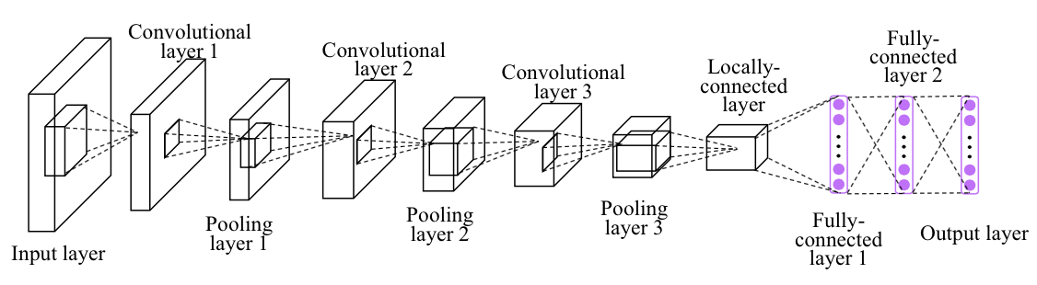
Deep CNN
Image credit: http://personal.ie.cuhk.edu.hk/~ccloy/project_target_code/index.html

Slide 29
Deep CNN
# L3 ImgIn shape=(?, 7, 7, 64)
W3 = tf.Variable(tf.random_normal([3, 3, 64, 128], stddev=0.01))
# Conv ->(?, 7, 7, 128)
# Pool ->(?, 4, 4, 128)
# Reshape ->(?, 4 * 4 * 128) # Flatten them for FC
L3 = tf.nn.conv2d(L2, W3, strides=[1, 1, 1, 1], padding='SAME')
L3 = tf.nn.relu(L3)
L3 = tf.nn.max_pool(L3, ksize=[1, 2, 2, 1], strides=[1, 2, 2, 1], padding='SAME')
L3 = tf.nn.dropout(L3, keep_prob=keep_prob)
L3 = tf.reshape(L3, [-1, 128 * 4 * 4])
'''Tensor("Conv2D_2:0", shape=(?, 7, 7, 128), dtype=float32)
Tensor("Relu_2:0", shape=(?, 7, 7, 128), dtype=float32)
Tensor("MaxPool_2:0", shape=(?, 4, 4, 128), dtype=float32)
Tensor("dropout_2/mul:0", shape=(?, 4, 4, 128), dtype=float32)
Tensor("Reshape_1:0", shape=(?, 2048), dtype=float32)'''
# L4 FC 4x4x128 inputs -> 625 outputs
W4 = tf.get_variable("W4", shape=[128 * 4 * 4, 625], initializer=tf.contrib.layers.xavier_initializer())
b4 = tf.Variable(tf.random_normal([625]))
L4 = tf.nn.relu(tf.matmul(L3, W4) + b4)
L4 = tf.nn.dropout(L4, keep_prob=keep_prob)
'''Tensor("Relu_3:0", shape=(?, 625), dtype=float32)
Tensor("dropout_3/mul:0", shape=(?, 625), dtype=float32)'''
# L5 Final FC 625 inputs -> 10 outputs
W5 = tf.get_variable("W5", shape=[625, 10], initializer=tf.contrib.layers.xavier_initializer())
b5 = tf.Variable(tf.random_normal([10]))
hypothesis = tf.matmul(L4, W5) + b5
'''Tensor("add_1:0", shape=(?, 10), dtype=float32)'''
# L1 ImgIn shape=(?, 28, 28, 1)
W1 = tf.Variable(tf.random_normal([3, 3, 1, 32], stddev=0.01))
# Conv -> (?, 28, 28, 32)
# Pool -> (?, 14, 14, 32)
L1 = tf.nn.conv2d(X_img, W1, strides=[1, 1, 1, 1], padding='SAME')
L1 = tf.nn.relu(L1)
L1 = tf.nn.max_pool(L1, ksize=[1, 2, 2, 1],
strides=[1, 2, 2, 1], padding='SAME')
L1 = tf.nn.dropout(L1, keep_prob=keep_prob)
'''Tensor("Conv2D:0", shape=(?, 28, 28, 32), dtype=float32)
Tensor("Relu:0", shape=(?, 28, 28, 32), dtype=float32)
Tensor("MaxPool:0", shape=(?, 14, 14, 32), dtype=float32)
Tensor("dropout/mul:0", shape=(?, 14, 14, 32), dtype=float32)'''
# L2 ImgIn shape=(?, 14, 14, 32)
W2 = tf.Variable(tf.random_normal([3, 3, 32, 64], stddev=0.01))
# Conv ->(?, 14, 14, 64)
# Pool ->(?, 7, 7, 64)
L2 = tf.nn.conv2d(L1, W2, strides=[1, 1, 1, 1], padding='SAME')
L2 = tf.nn.relu(L2)
L2 = tf.nn.max_pool(L2, ksize=[1, 2, 2, 1],
strides=[1, 2, 2, 1], padding='SAME')
L2 = tf.nn.dropout(L2, keep_prob=keep_prob)
'''Tensor("Conv2D_1:0", shape=(?, 14, 14, 64), dtype=float32)
Tensor("Relu_1:0", shape=(?, 14, 14, 64), dtype=float32)
Tensor("MaxPool_1:0", shape=(?, 7, 7, 64), dtype=float32)
Tensor("dropout_1/mul:0", shape=(?, 7, 7, 64), dtype=float32)'''
https://github.com/hunkim/DeepLearningZeroToAll/blob/master/lab-11-2-mnist_deep_cnn.py

Slide 30
Deep CNN
# L1 ImgIn shape=(?, 28, 28, 1)
W1 = tf.Variable(tf.random_normal([3, 3, 1, 32], stddev=0.01))
# Conv -> (?, 28, 28, 32)
# Pool -> (?, 14, 14, 32)
L1 = tf.nn.conv2d(X_img, W1, strides=[1, 1, 1, 1], padding='SAME')
L1 = tf.nn.relu(L1)
L1 = tf.nn.max_pool(L1, ksize=[1, 2, 2, 1],
strides=[1, 2, 2, 1], padding='SAME')
L1 = tf.nn.dropout(L1, keep_prob=keep_prob)
'''Tensor("Conv2D:0", shape=(?, 28, 28, 32), dtype=float32)
Tensor("Relu:0", shape=(?, 28, 28, 32), dtype=float32)
Tensor("MaxPool:0", shape=(?, 14, 14, 32), dtype=float32)
Tensor("dropout/mul:0", shape=(?, 14, 14, 32), dtype=float32)'''
...
...
# L4 FC 4x4x128 inputs -> 625 outputs
W4 = tf.get_variable("W4", shape=[128 * 4 * 4, 625], initializer=tf.contrib.layers.xavier_initializer())
b4 = tf.Variable(tf.random_normal([625]))
L4 = tf.nn.relu(tf.matmul(L3, W4) + b4)
L4 = tf.nn.dropout(L4, keep_prob=keep_prob)
'''Tensor("Relu_3:0", shape=(?, 625), dtype=float32)
Tensor("dropout_3/mul:0", shape=(?, 625), dtype=float32)'''
# L5 Final FC 625 inputs -> 10 outputs
W5 = tf.get_variable("W5", shape=[625, 10], initializer=tf.contrib.layers.xavier_initializer())
b5 = tf.Variable(tf.random_normal([10]))
hypothesis = tf.matmul(L4, W5) + b5
'''Tensor("add_1:0", shape=(?, 10), dtype=float32)'''
# Test model and check accuracy
correct_prediction = tf.equal(tf.argmax(hypothesis, 1),
tf.argmax(Y, 1))
accuracy = tf.reduce_mean(tf.cast(correct_prediction,tf.float32))
print('Accuracy:', sess.run(accuracy,
feed_dict={X: mnist.test.images,
Y: mnist.test.labels, keep_prob: 1}))
Epoch: 0013 cost = 0.027188021
Epoch: 0014 cost = 0.023604777
Epoch: 0015 cost = 0.024607201
Learning Finished!
Accuracy: 0.9938
https://github.com/hunkim/DeepLearningZeroToAll/blob/master/lab-11-2-mnist_deep_cnn.py

Slide 31
Lab 11-3
Class, Layers, Ensemble
With TF 1.0!
Sung Kim <hunkim+ml@gmail.com>
Code: https://github.com/hunkim/DeepLearningZeroToAll/

Slide 32
https://github.com/hunkim/DeepLearningZeroToAll/

Slide 33
CNN
# L1 ImgIn shape=(?, 28, 28, 1)
W1 = tf.Variable(tf.random_normal([3, 3, 1, 32], stddev=0.01))
# Conv -> (?, 28, 28, 32)
# Pool -> (?, 14, 14, 32)
L1 = tf.nn.conv2d(X_img, W1, strides=[1, 1, 1, 1], padding='SAME')
L1 = tf.nn.relu(L1)
L1 = tf.nn.max_pool(L1, ksize=[1, 2, 2, 1],
strides=[1, 2, 2, 1], padding='SAME')
L1 = tf.nn.dropout(L1, keep_prob=keep_prob)
'''Tensor("Conv2D:0", shape=(?, 28, 28, 32), dtype=float32)
Tensor("Relu:0", shape=(?, 28, 28, 32), dtype=float32)
Tensor("MaxPool:0", shape=(?, 14, 14, 32), dtype=float32)
Tensor("dropout/mul:0", shape=(?, 14, 14, 32), dtype=float32)'''
...
...
# L4 FC 4x4x128 inputs -> 625 outputs
W4 = tf.get_variable("W4", shape=[128 * 4 * 4, 625], initializer=tf.contrib.layers.xavier_initializer())
b4 = tf.Variable(tf.random_normal([625]))
L4 = tf.nn.relu(tf.matmul(L3, W4) + b4)
L4 = tf.nn.dropout(L4, keep_prob=keep_prob)
'''Tensor("Relu_3:0", shape=(?, 625), dtype=float32)
Tensor("dropout_3/mul:0", shape=(?, 625), dtype=float32)'''
# L5 Final FC 625 inputs -> 10 outputs
W5 = tf.get_variable("W5", shape=[625, 10], initializer=tf.contrib.layers.xavier_initializer())
b5 = tf.Variable(tf.random_normal([10]))
hypothesis = tf.matmul(L4, W5) + b5
'''Tensor("add_1:0", shape=(?, 10), dtype=float32)'''
# Test model and check accuracy
correct_prediction = tf.equal(tf.argmax(hypothesis, 1),
tf.argmax(Y, 1))
accuracy = tf.reduce_mean(tf.cast(correct_prediction,tf.float32))
print('Accuracy:', sess.run(accuracy,
feed_dict={X: mnist.test.images,
Y: mnist.test.labels, keep_prob: 1}))
Epoch: 0013 cost = 0.027188021
Epoch: 0014 cost = 0.023604777
Epoch: 0015 cost = 0.024607201
Learning Finished!
Accuracy: 0.9938
https://github.com/hunkim/DeepLearningZeroToAll/blob/master/lab-11-2-mnist_deep_cnn.py

Slide 34
Python Class
class Model:
def __init__(self, sess, name):
self.sess = sess
self.name = name
self._build_net()
def _build_net(self):
with tf.variable_scope(self.name):
# input place holders
self.X = tf.placeholder(tf.float32, [None, 784])
# img 28x28x1 (black/white)
X_img = tf.reshape(self.X, [-1, 28, 28, 1])
self.Y = tf.placeholder(tf.float32, [None, 10])
# L1 ImgIn shape=(?, 28, 28, 1)
W1 = tf.Variable(tf.random_normal([3, 3, 1, 32],
stddev=0.01))
...
def predict(self, x_test, keep_prop=1.0):
return self.sess.run(self.logits,
feed_dict={self.X: x_test, self.keep_prob: keep_prop})
def get_accuracy(self, x_test, y_test, keep_prop=1.0):
return self.sess.run(self.accuracy,
feed_dict={self.X: x_test, self.Y: y_test, self.keep_prob: keep_prop})
def train(self, x_data, y_data, keep_prop=0.7):
return self.sess.run([self.cost, self.optimizer], feed_dict={
self.X: x_data, self.Y: y_data, self.keep_prob: keep_prop})
# initialize
sess = tf.Session()
m1 = Model(sess, "m1")
sess.run(tf.global_variables_initializer())
print('Learning Started!')
# train my model
for epoch in range(training_epochs):
avg_cost = 0
total_batch = int(mnist.train.num_examples / batch_size)
for i in range(total_batch):
batch_xs, batch_ys = mnist.train.next_batch(batch_size)
c, _ = m1.train(batch_xs, batch_ys)
avg_cost += c / total_batc
https://github.com/hunkim/DeepLearningZeroToAll/blob/master/lab-11-3-mnist_cnn_class.py

Slide 35
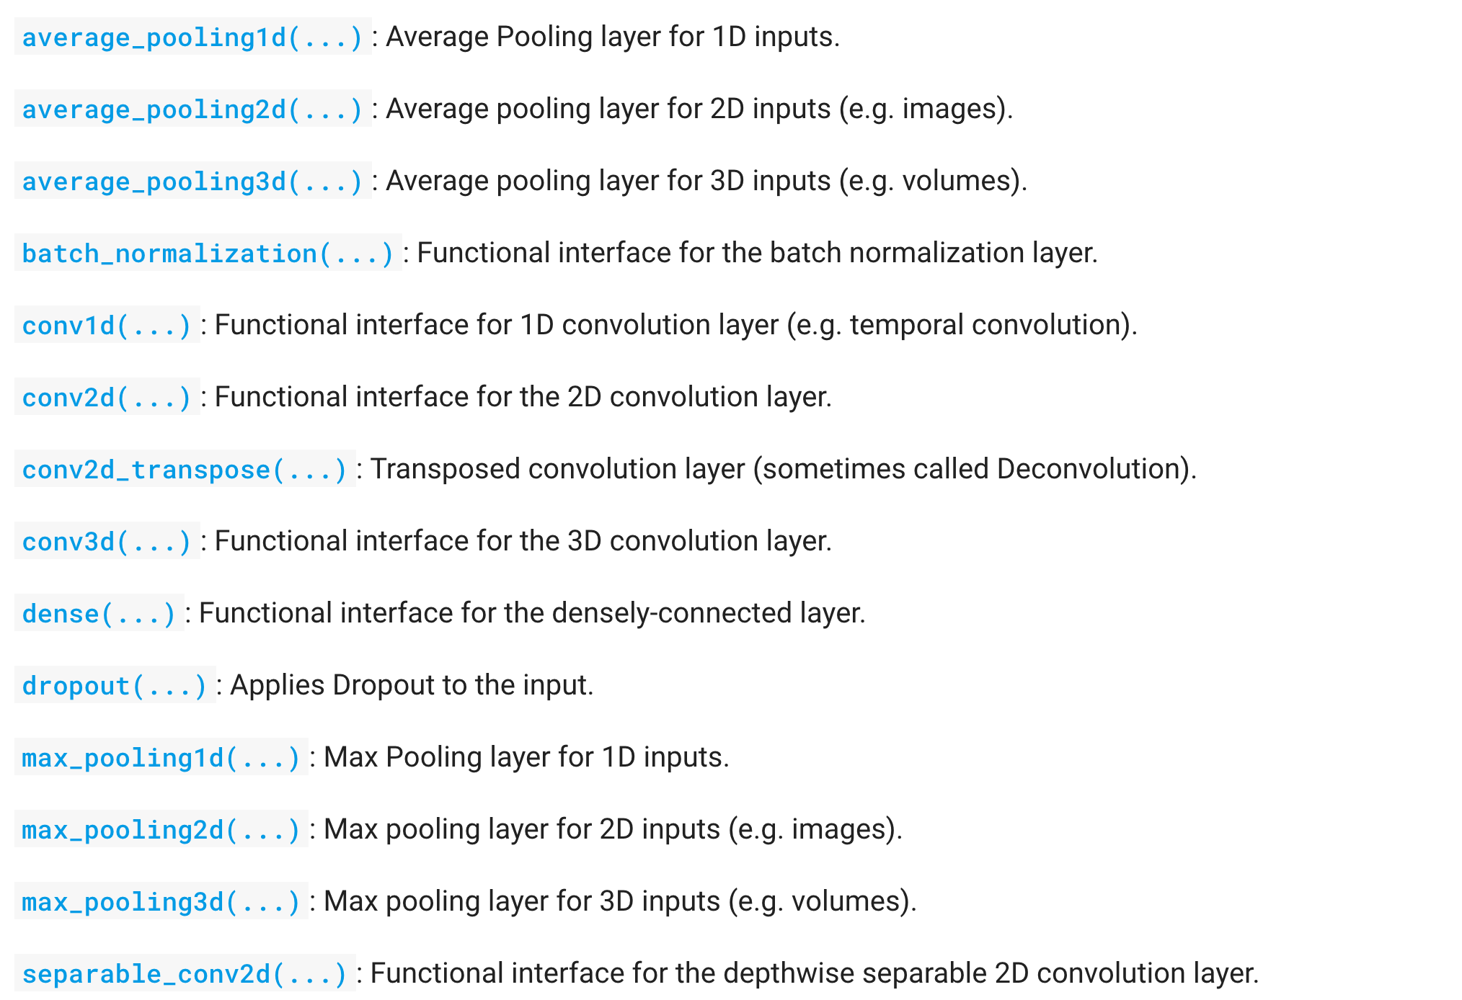
tf.layers
https://www.tensorflow.org/api_docs/python/tf/layers

Slide 36
tf.layers
# L1 ImgIn shape=(?, 28, 28, 1)
W1 = tf.Variable(tf.random_normal([3, 3, 1, 32], stddev=0.01))
# Conv -> (?, 28, 28, 32)
# Pool -> (?, 14, 14, 32)
L1 = tf.nn.conv2d(X_img, W1, strides=[1, 1, 1, 1], padding='SAME')
L1 = tf.nn.relu(L1)
L1 = tf.nn.max_pool(L1, ksize=[1, 2, 2, 1], strides=[1, 2, 2, 1], padding='SAME')
L1 = tf.nn.dropout(L1, keep_prob=self.keep_prob)
…
# L2 ImgIn shape=(?, 14, 14, 32)
W2 = tf.Variable(tf.random_normal([3, 3, 32, 64], stddev=0.01))
# Convolutional Layer #1
conv1 = tf.layers.conv2d(inputs=X_img,filters=32,kernel_size=[3,3],padding="SAME",activation=tf.nn.relu)
pool1 = tf.layers.max_pooling2d(inputs=conv1, pool_size=[2, 2], padding="SAME", strides=2)
dropout1 = tf.layers.dropout(inputs=pool1,rate=0.7, training=self.training)
# Convolutional Layer #2
conv2 = tf.layers.conv2d(inputs=dropout1,filters=64,kernel_size=[3,3],padding="SAME",activation=tf.nn.relu)
…
flat = tf.reshape(dropout3, [-1, 128 * 4 * 4])
dense4 = tf.layers.dense(inputs=flat, units=625, activation=tf.nn.relu)
dropout4 = tf.layers.dropout(inputs=dense4, rate=0.5, training=self.training)
...
https://github.com/hunkim/DeepLearningZeroToAll/blob/master/lab-11-4-mnist_cnn_layers.py

Slide 37
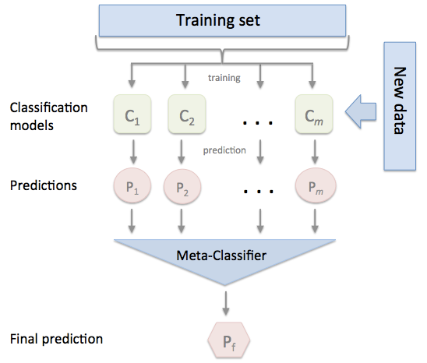
Ensemble
http://rasbt.github.io/mlxtend/user_guide/classifier/StackingClassifier/

Slide 38
Ensemble
training
models = []
num_models = 7
for m in range(num_models):
models.append(Model(sess, "model" + str(m)))
sess.run(tf.global_variables_initializer())
print('Learning Started!')
# train my model
for epoch in range(training_epochs):
avg_cost_list = np.zeros(len(models))
total_batch = int(mnist.train.num_examples / batch_size)
for i in range(total_batch):
batch_xs, batch_ys =mnist.train.next_batch(batch_size)
# train each model
for m_idx, m in enumerate(models):
c, _ = m.train(batch_xs, batch_ys)
avg_cost_list[m_idx] += c / total_batch
print('Epoch:','%04d'%(epoch + 1),'cost =', avg_cost_list)
print('Learning Finished!')
class Model:
def __init__(self, sess, name):
self.sess = sess
self.name = name
self._build_net()
def _build_net(self):
with tf.variable_scope(self.name):
...
https://github.com/hunkim/DeepLearningZeroToAll/blob/master/lab-11-5-mnist_cnn_ensemble_layers.py

Slide 40
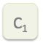
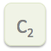
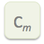
Ensemble prediction

Slide 41
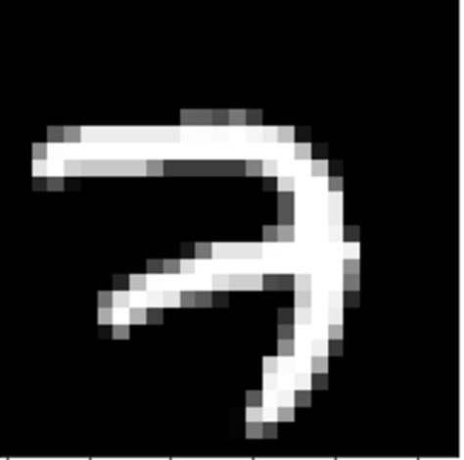
Ensemble prediction
0 | 1 | 2 | 3 | 4 | 5 | 6 | 7 | 8 | 9
0.1 | 0.01 | 0.02 | 0.8 | ... | ... | ... | ... | ... | ...
0.01 | 0.5 | 0.02 | 0.4 | ... | ... | ... | ... | ... | ...
.
.
.
0.01 | 0.01 | 0.1 | 0.7 | ... | ... | ... | ... | ... | ...
Sum
0.12 | 0.52 | 0.14 | 1.9 | ... | ... | ... | ... | ... | ...
argmax

Slide 42
Ensemble
prediction
# Test model and check accuracy
test_size = len(mnist.test.labels)
predictions = np.zeros(test_size * 10).reshape(test_size, 10)
for m_idx, m in enumerate(models):
print(m_idx, 'Accuracy:', m.get_accuracy(mnist.test.images, mnist.test.labels))
p = m.predict(mnist.test.images)
predictions += p
ensemble_correct_prediction = tf.equal(
tf.argmax(predictions, 1), tf.argmax(mnist.test.labels, 1))
ensemble_accuracy = tf.reduce_mean(
tf.cast(ensemble_correct_prediction, tf.float32))
print('Ensemble accuracy:', sess.run(ensemble_accuracy))
'0 Accuracy: 0.9933
1 Accuracy: 0.9946
2 Accuracy: 0.9934
3 Accuracy: 0.9935
4 Accuracy: 0.9935
5 Accuracy: 0.9949
6 Accuracy: 0.9941
Ensemble accuracy: 0.9952
https://github.com/hunkim/DeepLearningZeroToAll/blob/master/lab-11-5-mnist_cnn_ensemble_layers.py

Slide 43
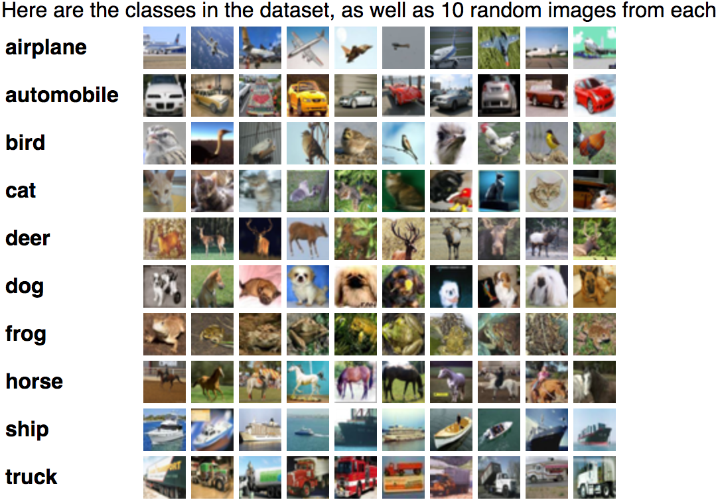
Exercise
Deep & Wide?
CIFAR 10
ImageNet

Slide 44
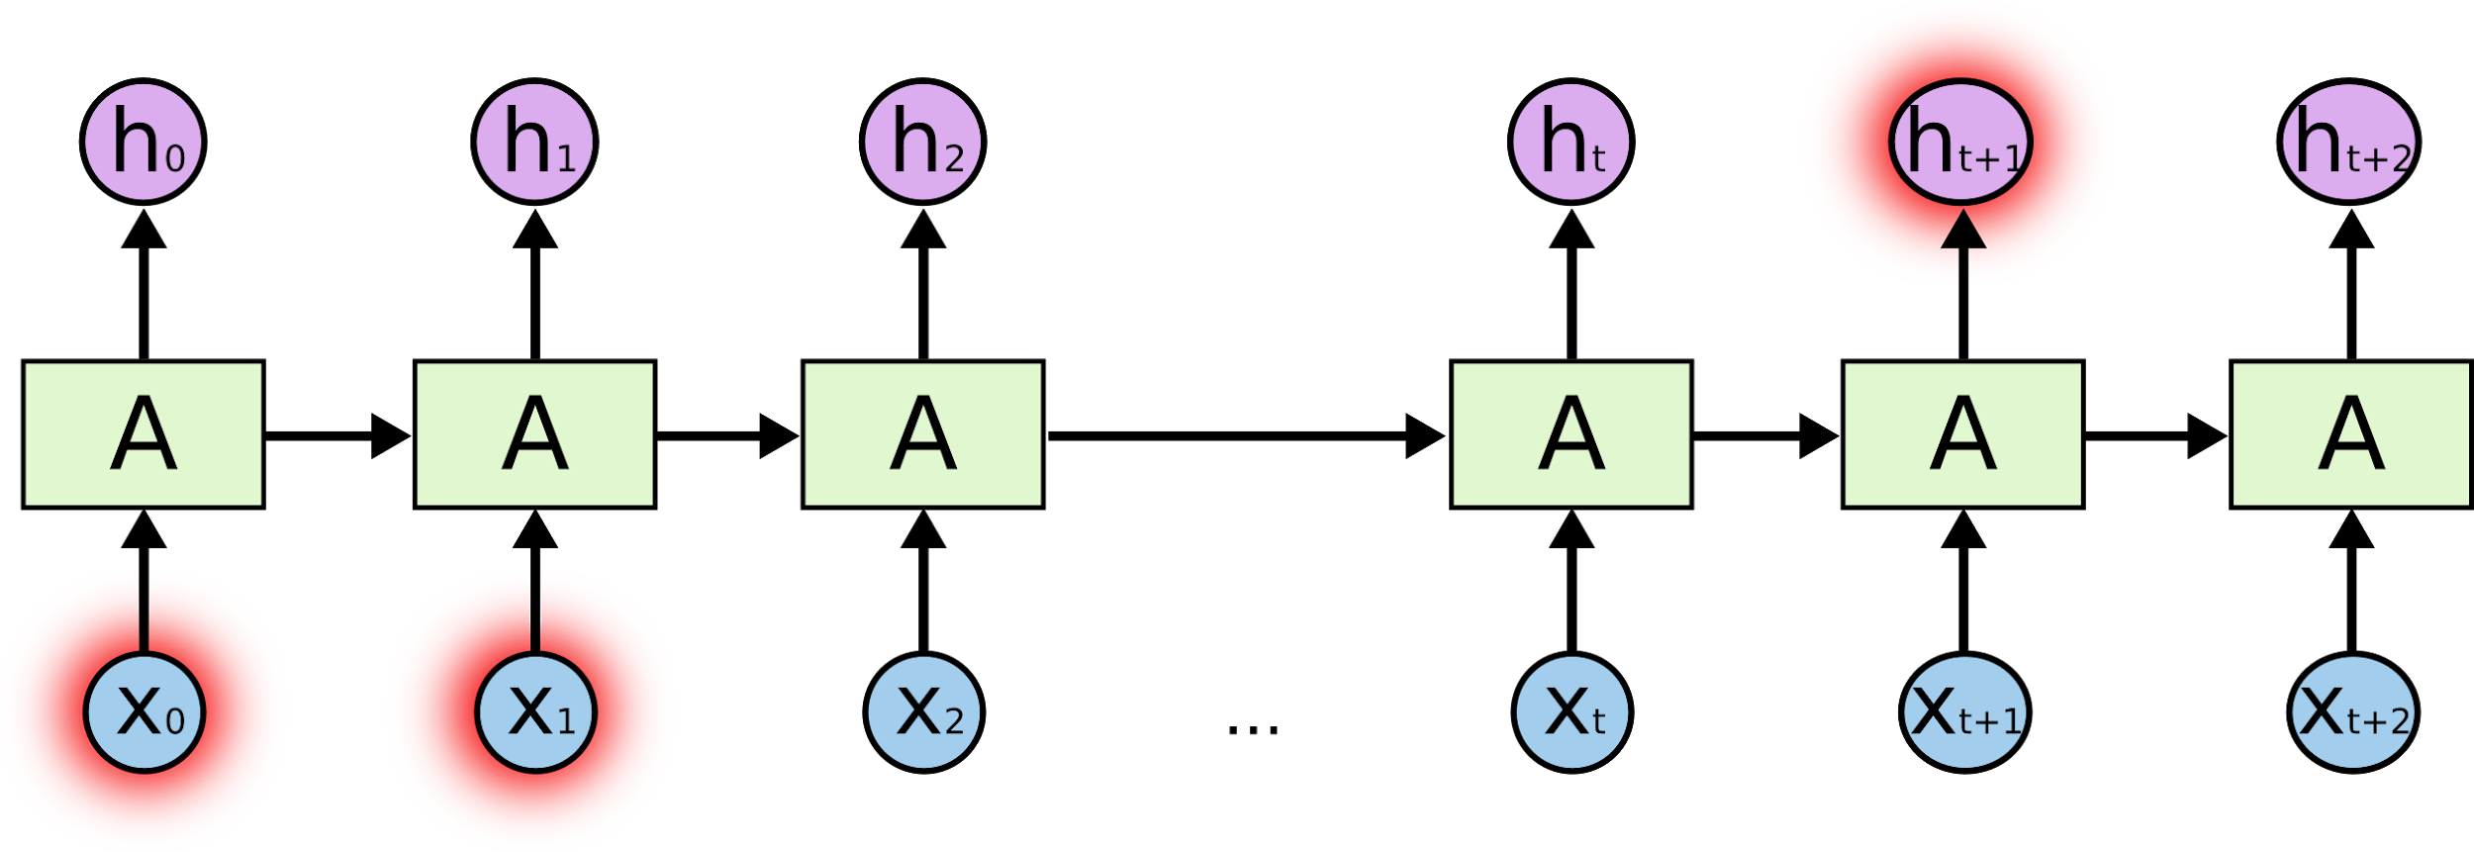
Lab 12
RNN
Sung Kim <hunkim+ml@gmail.com>
http://hunkim.github.io/ml/

